Slide 1
8. Sorting in Linear Time

Slide 2
8.1 Lower bound for sorting
The decision tree model

Slide 3
A lower bound for the worse case
Theorem 8.1. Any decision tree that sorts n elements has height Ω(n lgn).
Proof:
n! ≤ l ≤ 2^{h}
h ≥ lg (n!) = Ω(n lgn)
Corollary 8.2 Heapsort and merge sort are asymptotically optimal comparisons.

Slide 4
Pseudocode of counting sort
COUNTING-SORT(A, B)
1 for j ← 0 to m do C[j] ← 0
2 for i ← 1 to length[A] INCR(C[A[i]])
3 for j ← 1 to m do C[j] = C[j-1]+C[j]
4 for i ← length[A] downto 1
5 do B[C[A[i]]] ← A[i]
6 DESC(C[A[i]])
Assume all keys are in the range from 0 to m and the result is stored in B. C is a temporary working storage for “counting” of each numbers.
cost
m+1
n
m
n

Slide 5
Analysis of counting sort
when
Not a comparison sort (T(n) = Ω(n lgn) for all sorting methods based on comparison).
Property: stable (numbers with the same value appear in the output array in the same order as they do in the input array.).
Useful in the number-can-be-quantized situations, especially when m is small relative to n.
Can work with other sorting methods like radix sort.

Slide 6
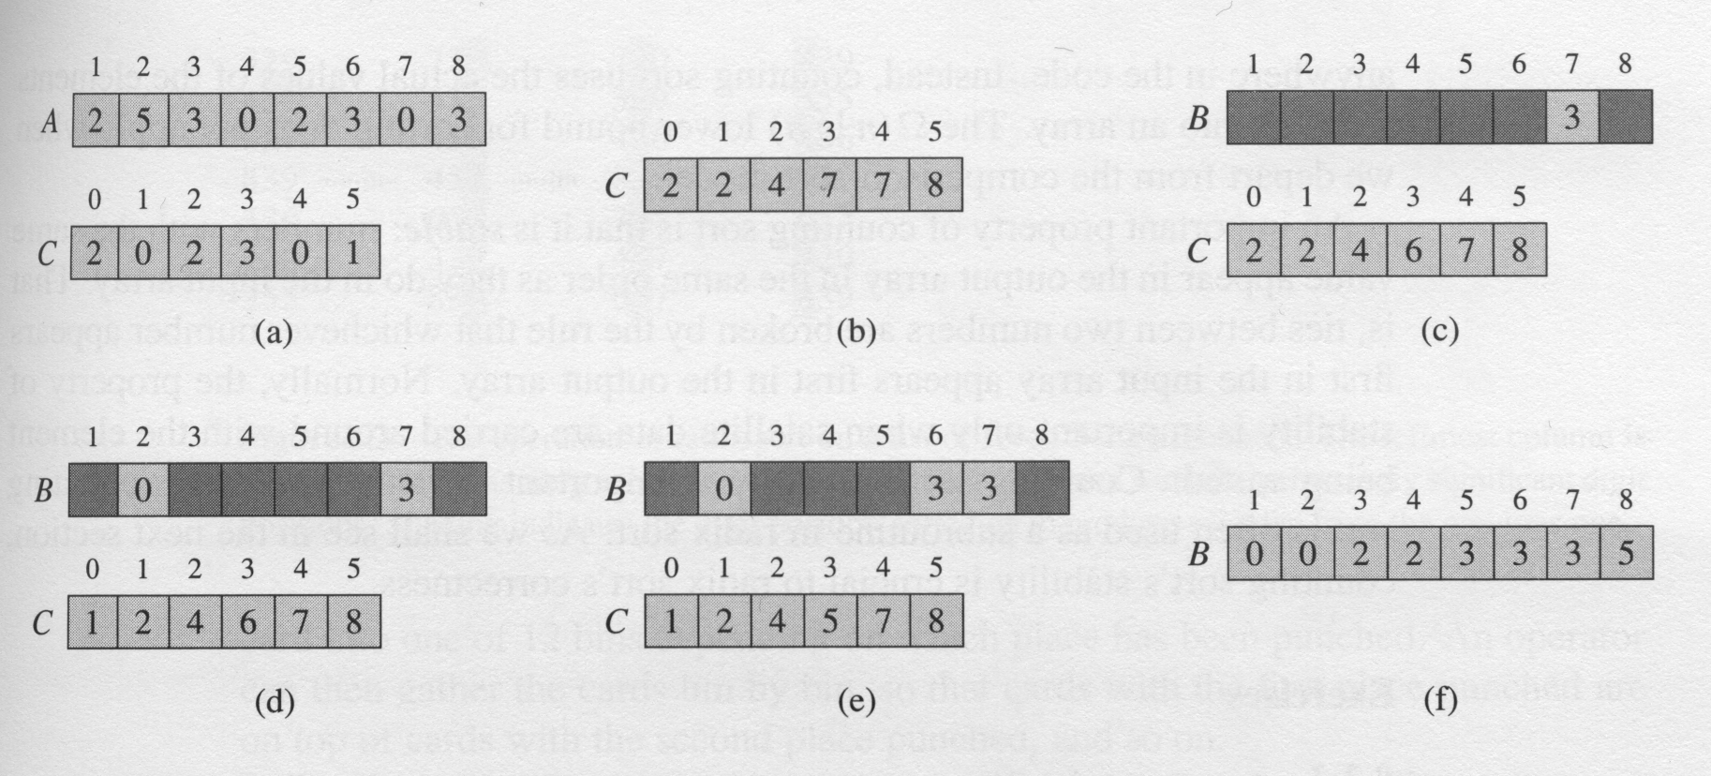
The operation of counting-sort on an input array A[1..8]

Slide 7
The idea of radix sort
Used by the card-sorting machines you can now find only in computer museums.
Any number can be represented in radix-b notation.
Examples:
16536 = 1 ⋅ 10⁴ + 6 ⋅ 10³ + 5 ⋅ 10² + 3 ⋅ 10¹ + 6 ⋅ 10⁰
⟨101101⟩₂ = 1 ⋅ 2⁵ + 0 ⋅ 2⁴ + 1 ⋅ 2³ + 1 ⋅ 2² + 0 ⋅ 2¹ + 1 ⋅ 2⁰ = 45
In general, we choose some basis b and write
x = ⟨ x_{k}x_{k – 1}...x₀ ⟩_{b} = x_{k} ⋅ b^{k} + x_{k – 1} ⋅ b^{k – 1} + ··· + x₀ ⋅ b⁰
How do we compare two numbers in radix-10 notation? How would we sort them?

Slide 8
Radix sort (high to low)
RADIX_SORTH2L(A, d)
1 RADIX_SORTH2L(A, d, 1, length[A])
RADIX_SORTH2L(A, d, p, q)
1 do sort array A on digit d
2 if d > 1
3 then si ← p
4 for i ← p to q – 1
5 if A[i, d] ≠ A[i+1, d]
6 RADIX_SORTH2L(A, d-1, si, i)
7 si ← i+1
8 RADIX_SORTH2L(A, d-1, si, q)
329 329 329 329
457 355 355 355
803 457 436 436
657 436 457 457
839 ⇒ 657 ⇒ 657 ⇒ 657
436 720 720 720
720 803 803 803
815 839 815 815
355 815 839 839
p, si
d
q

Slide 9
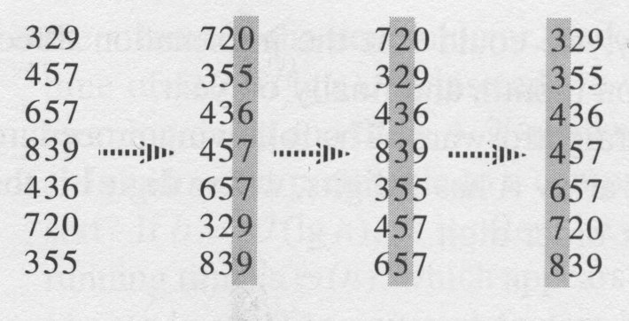
Radix sort (low to high)
RADIX_SORTL2H(A, d)
1 for i ← 1 to d
2 do use a stable sort to sort array A on digit i

Slide 10
Complexity analysis
Lemma 8.3
Given n d-digit numbers in which each digit can take on up to k possible values, RADIX-SORT correctly sorts these numbers in Θ(d(n + k)) time.
NOTE: not in-place (in-place: only constant number of elements of the input array are ever stored outside the array.)

Slide 11
Complexity analysis (cont.)
Lemma 8.4
Given n b-bit numbers and any positive integer r ≤ b, RADIX-SORT correctly sorts these numbers in Θ((b/r)(n+2^{r})) time.
Proof :
Choose d = ⎡b / r⎤.
Discussion:
Case 1: If b < ⎣lg n⎦, choose r = b, Θ((b/r)(n+2^{r})) = Θ(n)
Case 2: If b ≥ ⎣lg n⎦, choose r = ⎣lg n⎦
Θ((b/r)(n+2^{r})) = Θ(bn / lgn)

